Slide 1

Remaining Useful Life (RUL) Predictor for NMC-LCO 18650 Batteries
By Prakash Parajuli email: prakashparajuli2046@gmail.com

Slide 2
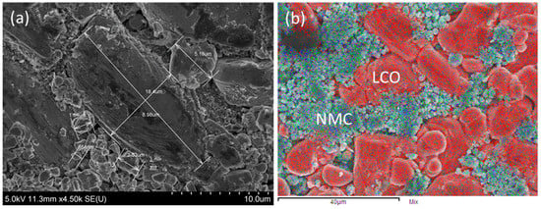
Objectives:
Develop an RUL Predictor: Leverage the available dataset to construct a predictive model that accurately estimates the Remaining Useful Life (RUL) of the batteries, closely aligning with observed values.
Explore Various ML Algorithms: Evaluate multiple machine learning algorithms to determine the most effective approach for accurate RUL prediction.
Align with Previous Research Experience: Leverage my background of researcher in battery to transition into a data science career.

Slide 3
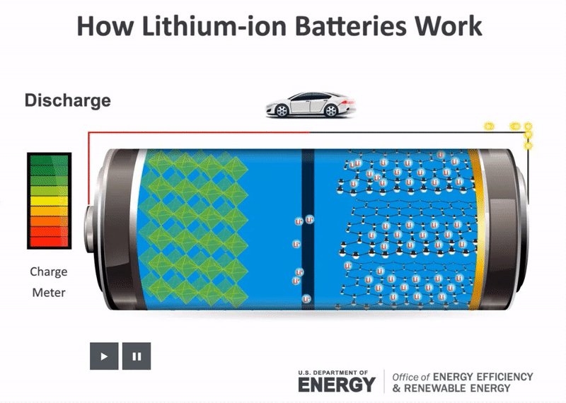
Objectives:
Charging: The electrons are forced to released at the cathode and move externally to the anode. Simultaneously, the Li-ions move in the same direction, but internally, from cathode to anode via the electrolyte.
Discharging: The electrons move from anode to cathode through external load. Simultaneously, the Li-ions move in the same direction, but internally, from anode to cathode via the electrolyte.

Slide 4
Data Source:
The data is available for download on https://www.kaggle.com/datasets/ignaciovinuales/battery-remaining-useful-life-rul.
The dataset is originally from Hawaii Natural Energy Institute (HNEI) used in the publication "Intrinsic Variability in the Degradation of a Batch of Commercial 18650 Lithium-Ion Cells"
It consists of 14 commercial 18650 cells with a graphite negative electrode and a blended positive electrode composed of NMC and LCO.
The cell was cycled at 1.5 C to 100% depth of discharge (DOD) for more than 1000 cycles at room temperature. This study examines the influence of intrinsic cell-to-cell variations on aging.

Slide 5
Features
Cycle_Index
Discharge Time (s)
Decrement 3.6-3.4V (s)
Max. Voltage Dischar. (V)
Min. Voltage Charg. (V)
Time at 4.15V (s)
Time constant current (s)
Charging time (s)
RUL

Slide 6
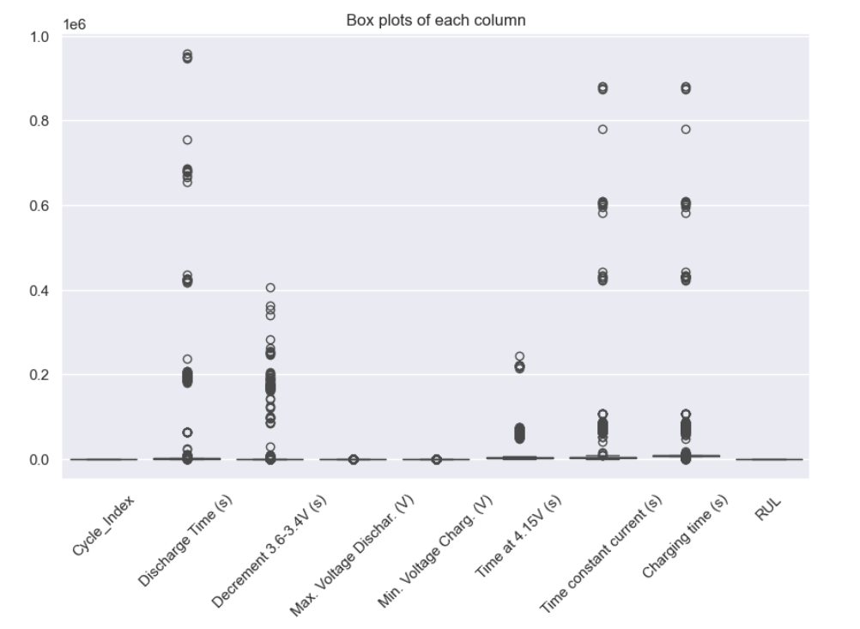
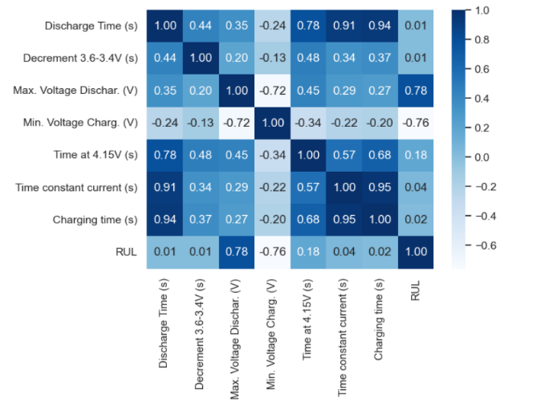
Data Wrangling: Before

Slide 7
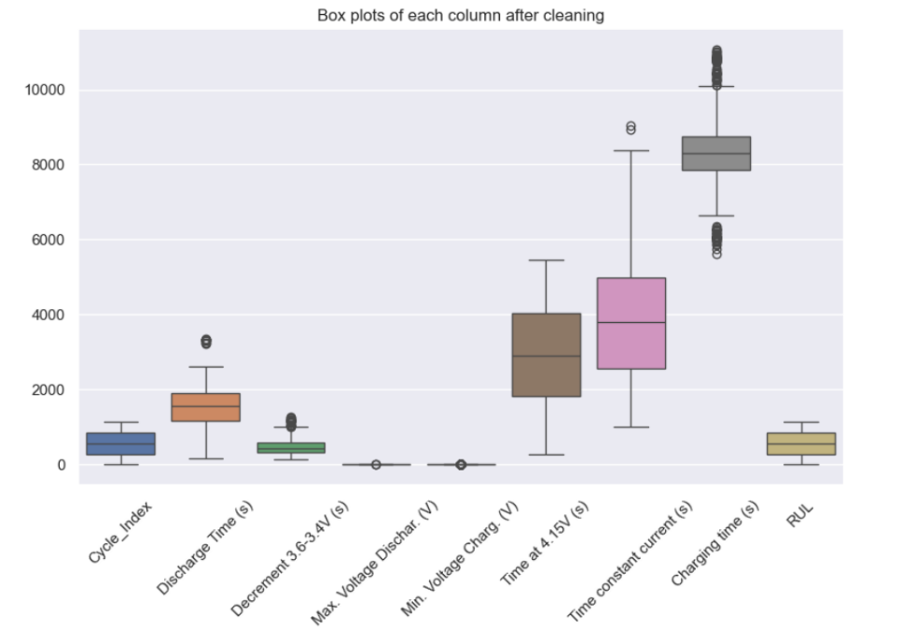
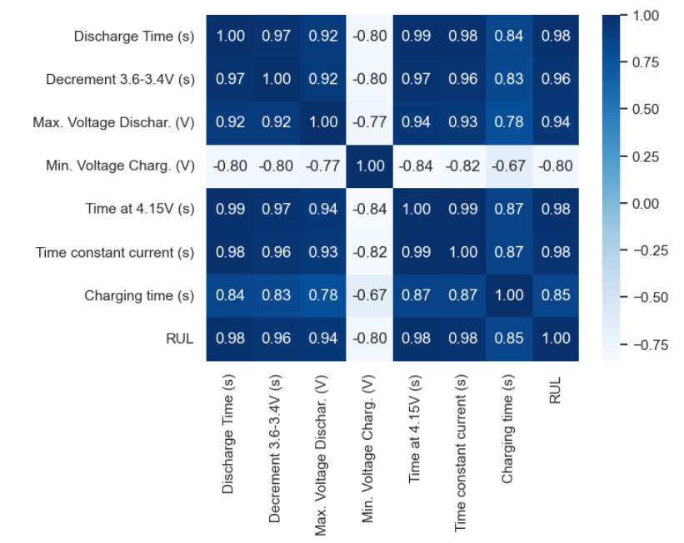
Data Wrangling: After

Slide 8
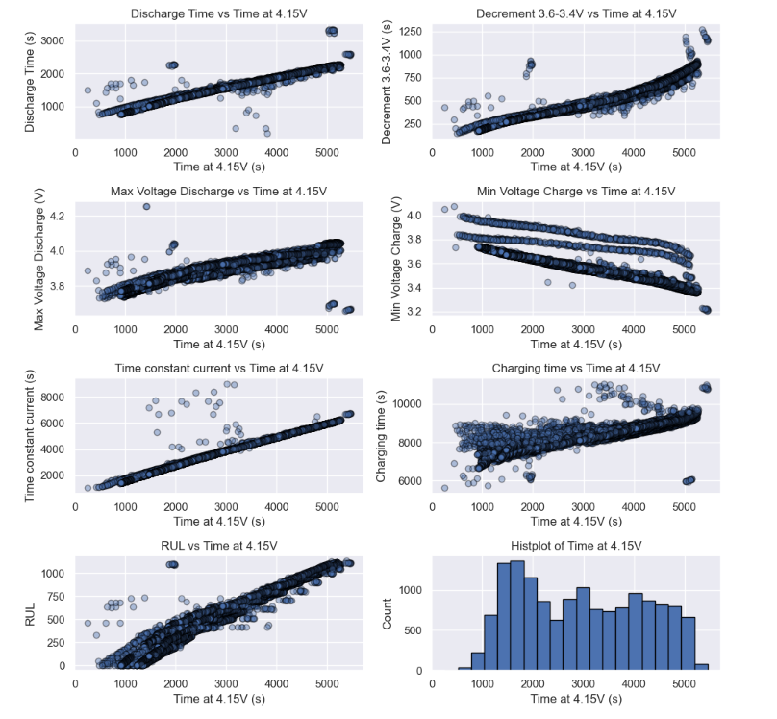
Exploratory Data Analysis: Most correlated Feature

Slide 9
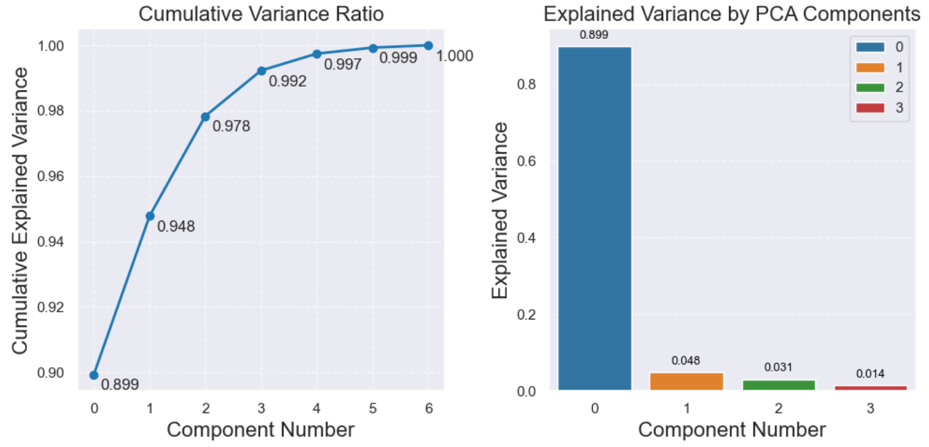
Principal Component Analysis (PCA)
The data is almost one dimensional.
One could consider it to be of 2 dimensional which explains almost 95% of variance.
0.95

Slide 10
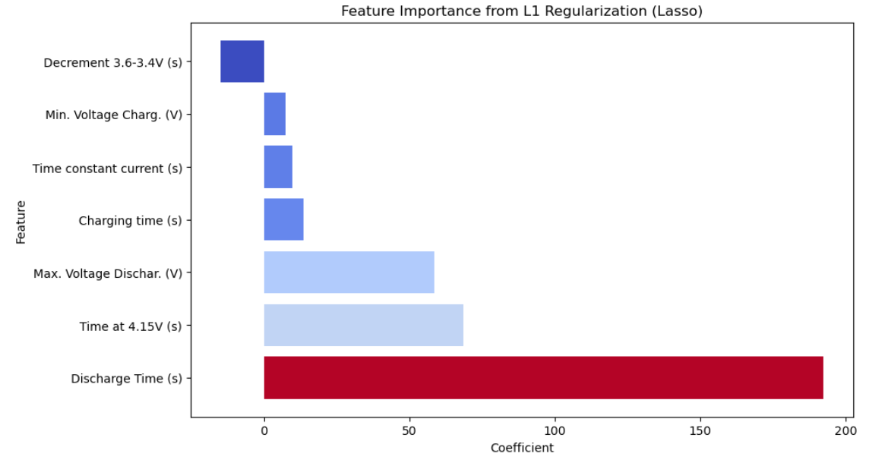
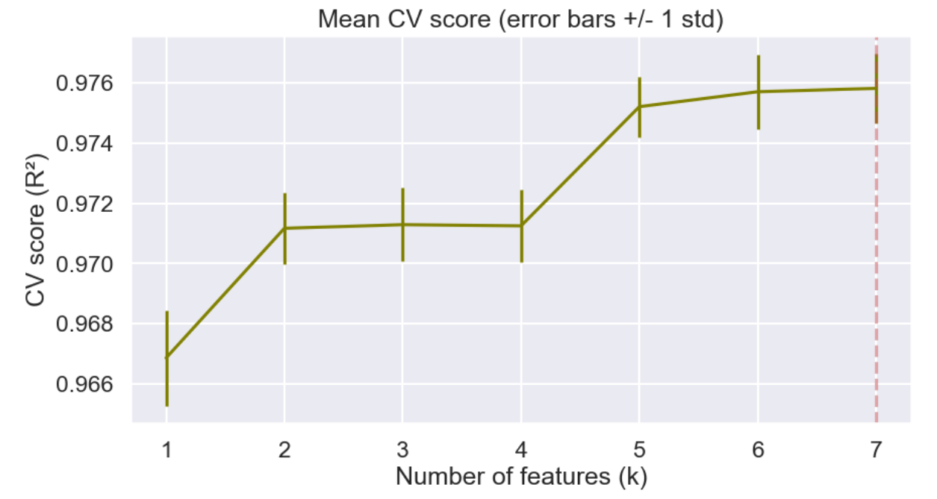
Feature Engineering and feature importance (Lasso)
Model Specificity: Feature importances are specific to the Lasso model; other models may yield different results, necessitating the retention of all features for comprehensive analysis.
Diminishing Returns: The R² score increased only marginally with additional features (peaking at 0.9758), indicating that the initial features already capture most of the variance in the data.
Performance Optimization: All features collectively lead to improved predictions, and the feature importance analysis yielded consistent results, reinforcing the value of retaining them.
Data Limitations: The dataset is specific to certain batteries, making it impractical to add new features without access to additional data.

Slide 11
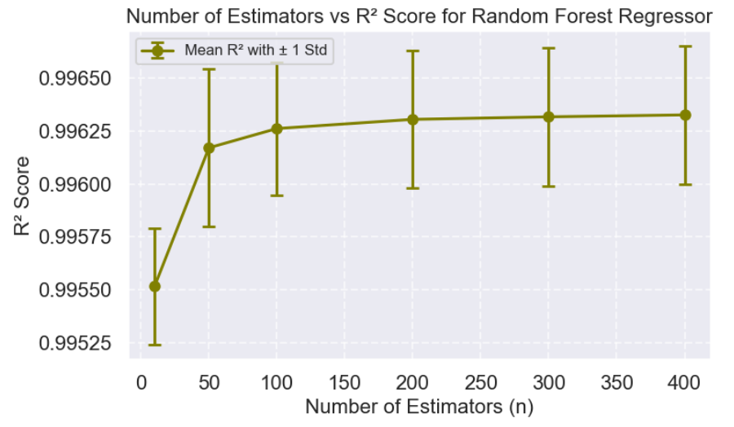
Random Forest Regressor: Number of Estimators
The optimal value for n_estimators is 400, achieving the highest R² score of 0.996326 with a very small standard deviation (0.000327), indicating excellent and stable performance.
As the number of estimators increases from 10 to 400, the R² score improves, suggesting that more estimators generally enhance model performance.
Improvements become marginal beyond 200 estimators.

Slide 12
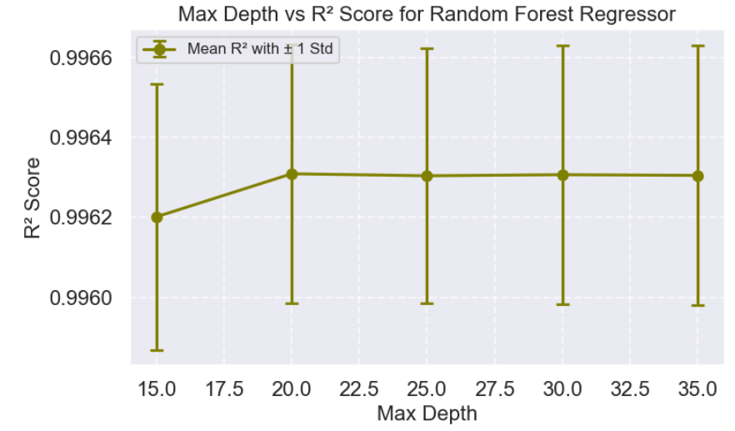
Random Forest Regressor: Max Depth
The optimal value for max_depth is 20, achieving the highest R² score of 0.996309 with a stable standard deviation (0.000324).
The R² score improves as max_depth increases from 15 to 20.
Beyond max_depth of 20, the score remains fairly stable with only slight changes.

Slide 13
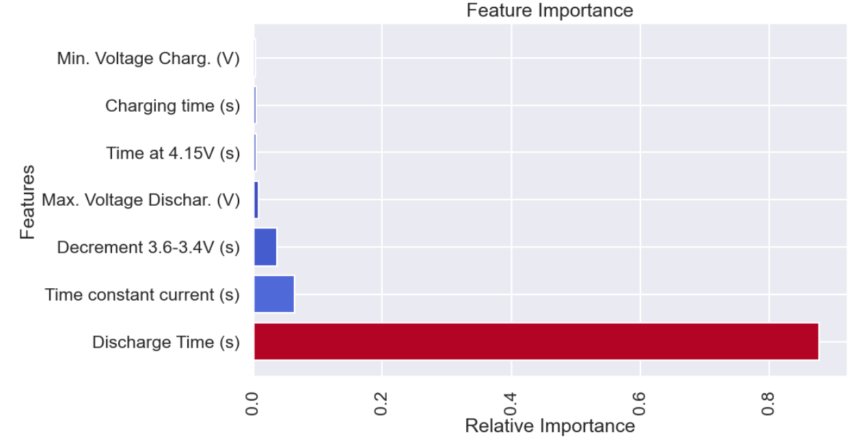
Random Forest Regressor: Feature Importance
Most Important Feature: Discharge Time (s) has the highest importance score (0.876475), indicating it is the most significant feature in predicting the target variable.
Least Important Feature: Min. Voltage Charg. (V) has the lowest importance score (0.003296), making it the least influential feature in the model.

Slide 14
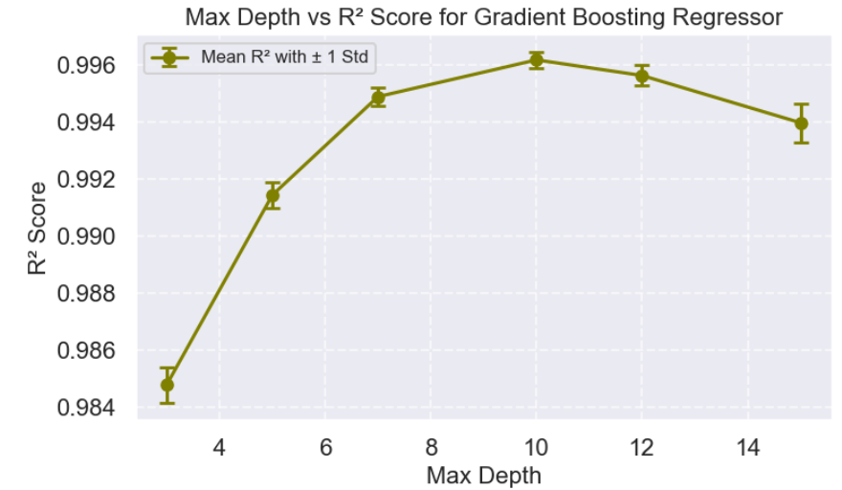
Gradient Boosting Regressor: Max_depth
The model with max_depth = 10 achieved the highest R² score of 0.9962, indicating the best fit on the test data.
R² score improves consistently as max_depth increases from 3 to 10.
Beyond max_depth = 10, the R² score decreases, and max_depth = 15 shows a higher standard deviation, suggesting potential overfitting.

Slide 15
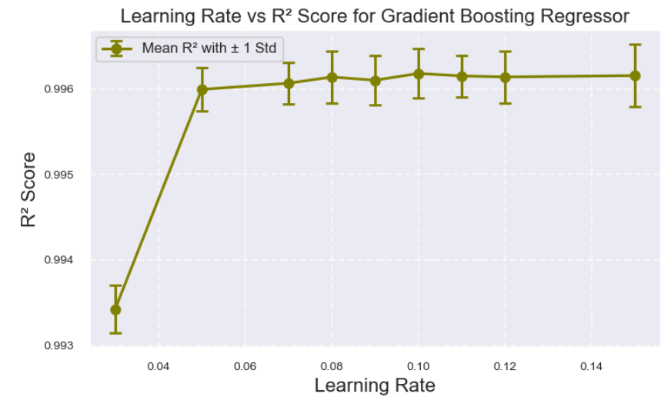
Gradient Boosting Regressor: Learning Rate
The model with a learning_rate of 0.10 achieved the highest R² score of 0.996181, indicating the best performance on the test data.
Increasing the learning_rate from 0.03 to 0.10 generally improves the R² score.
Beyond a learning_rate of 0.10, scores remain stable with minimal differences, and the standard deviations are small and consistent, indicating stable performance.

Slide 16
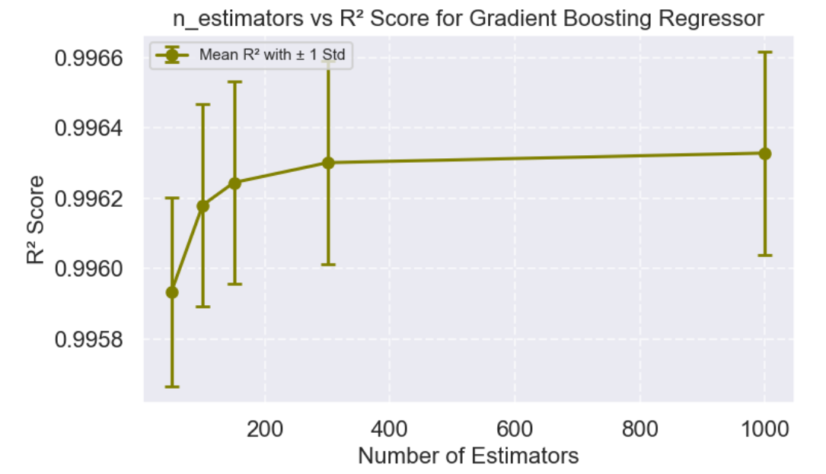
Gradient Boosting Regressor: Number of Estimators
The model with n_estimators = 1000 achieves the highest R² score of 0.996329, indicating the best performance with a very low standard deviation.
As the number of estimators increases, the R² score gradually improves, suggesting that more estimators enhance the model's ability to fit the data.
While the R² score continues to improve with more estimators, increases become marginal beyond 300 estimators, and the standard deviation remains stable across all values.

Slide 17
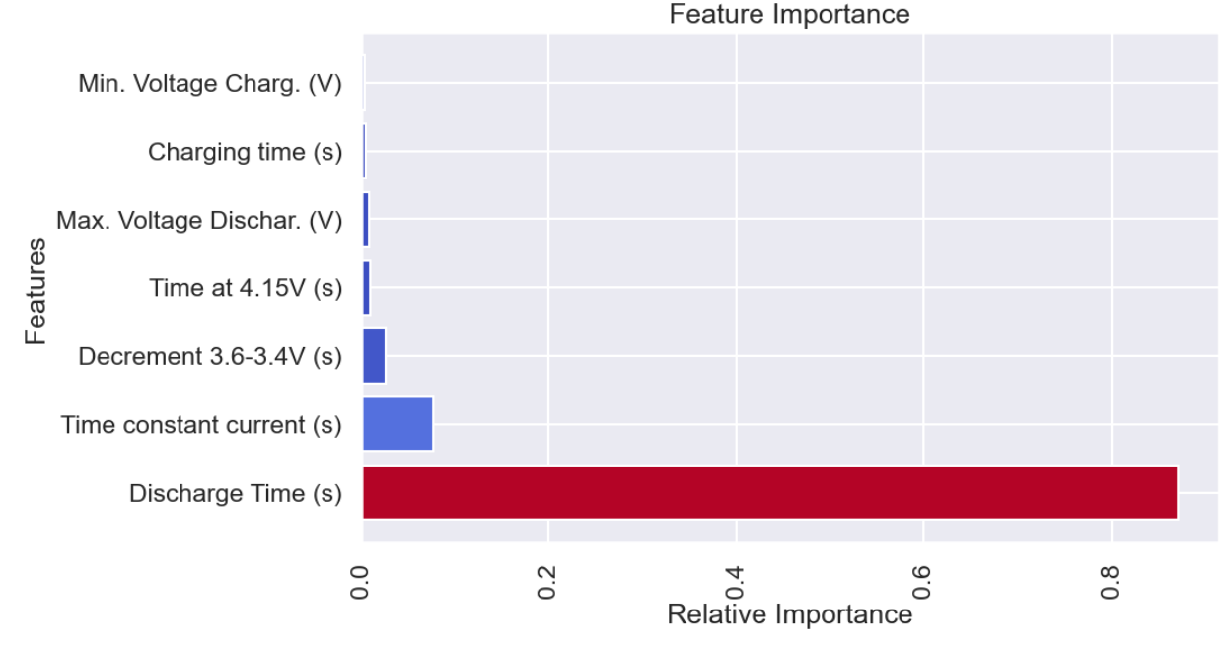
Gradient Boosting Regressor: Feature Importance
Most Important Feature: Discharge Time (s) has the highest importance score (0.869010), indicating it is the most significant feature for predicting the target variable.
Least Important Features: Min. Voltage Charg. (V) has the lowest importance score (0.003388), making it the least influential feature in the model.
These results indicate that, similar to the Random Forest Regressor, Discharge Time (s) plays a dominant role in the model’s predictions, while other features contribute less to overall performance.

Slide 18
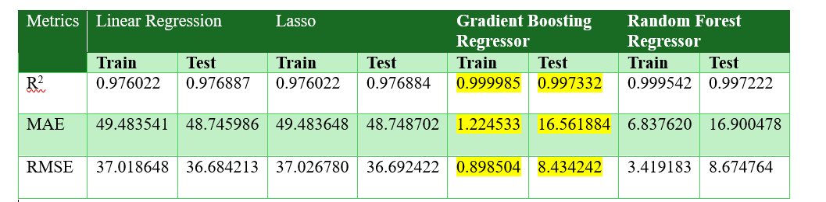
Model Evaluation:
The Gradient Boosting Regressor (GBR) model achieved the highest R² scores along with the lowest MAE and RMSE on the training set.
On the test set, the GBR’s performance was slightly better than that of the Random Forest Regressor (RFR).
These metrics highlight GBR’s strong predictive performance on both training and test data.

Slide 19
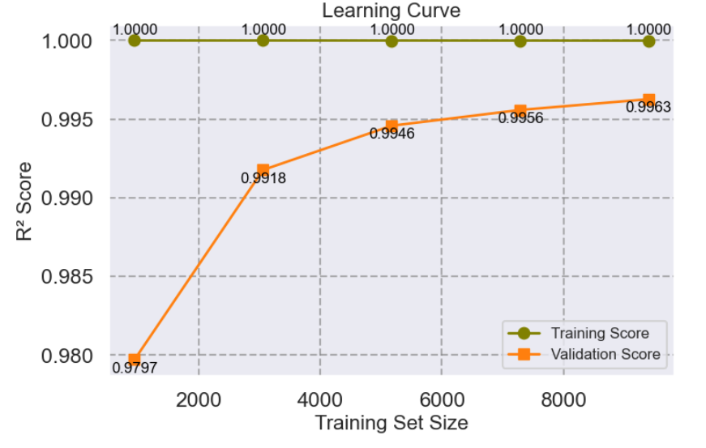
Model Evaluation: Learning Curve for GBR
High Training Scores: The model achieves consistently high training scores (close to 1.000), indicating excellent fit to the training data. May be even memorizing it?
Improving Test Scores: Test scores increase from 0.979695 to 0.996268 as training size grows, showing enhanced generalization.
Narrowing Gap: The gap between training and test scores decreases with larger training sizes, suggesting reduced overfitting and improved robustness.

Slide 20
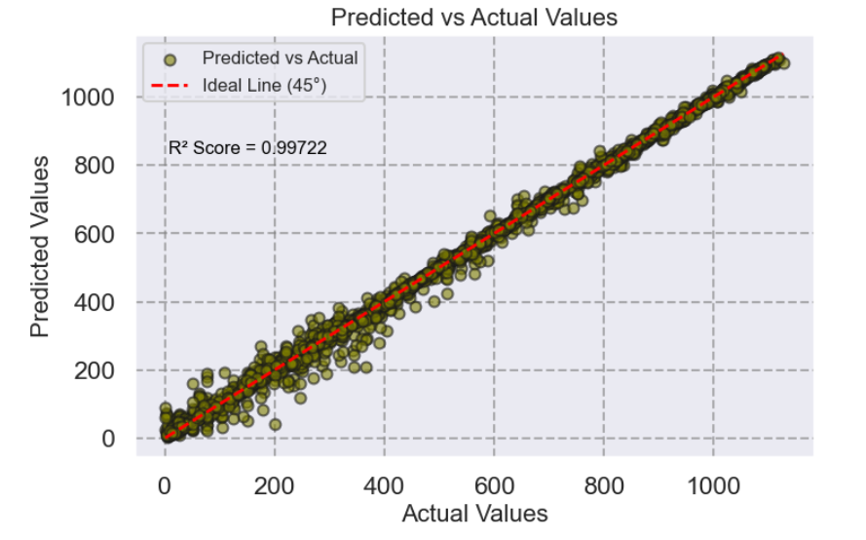
Model Evaluation: Predicted vs Actual Values for GBR

Slide 21
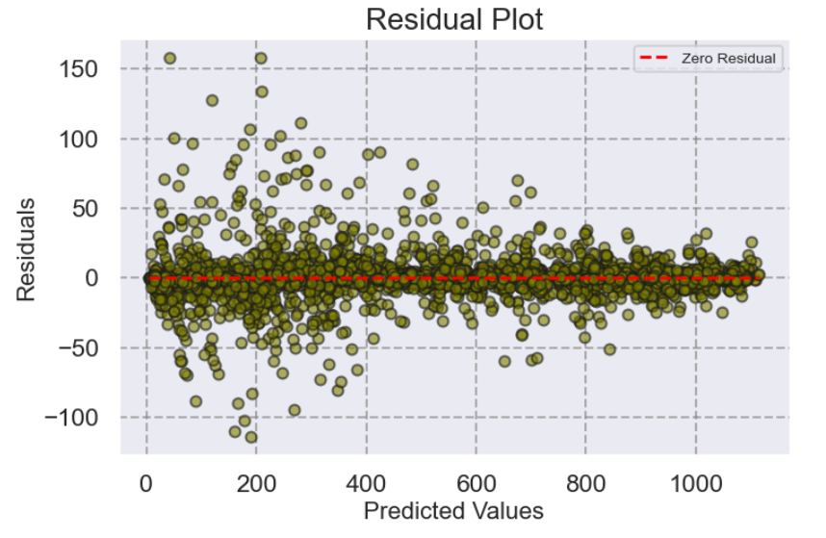
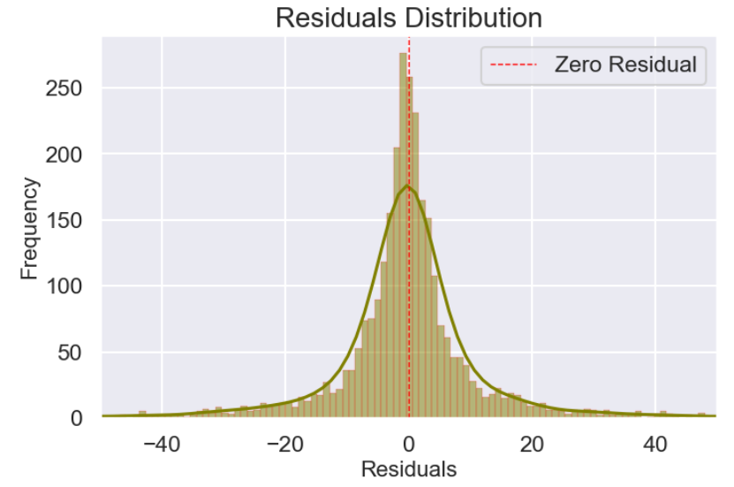
Model Evaluation: Symmetric Residuals for GBR

Slide 22

Conclusions:
Linear Model and Lasso Regression: Both models exhibited strong predictive capabilities, evidenced by high R² scores. The Lasso Regression, with an alpha of 0.01, demonstrated nearly identical performance metrics to the linear model, indicating that feature selection was not a significant factor in this context.
Gradient Boosting Regressor (GBR): This model achieved the highest R² scores along with the lowest MAE and RMSE on the training set, although its performance on the test set was slightly better than that of the RFR. It is important to note that GBR requires considerably more computational time for training.
Random Forest Regressor (RFR): This model provided performance metrics that were very close to those of GBR, featuring slightly higher MAE and RMSE but similar R² scores. RFR is more computationally efficient and trains faster than GBR.

Slide 23
Future Recommendation:
Limited Experimental Setup: The dataset currently consists of a single experimental setup (2.8 Ah nominal capacity, cycled 1000 times at 25 °C with specific charge and discharge rates), which may not reflect real-world conditions.
Need for Real-World Data: Acquiring diverse real-world data encompassing various charging/discharging conditions and environmental variables (e.g., temperature, humidity, pressure) would improve the model's applicability
Increasing Dataset Size: Expanding the number of batteries in the dataset could enhance the model's predictability and robustness for more diverse dataset, providing a more comprehensive understanding of battery performance under varied conditions.

Slide 24
Acknowledgment
Ignacio Vinuales for making the dataset publicly available,
Vinit Koshti, for his insightful guidance and thoughtful advice.

Slide 25

Thank you!
Thank you!

